Slide 1







Creative solutions for better business
www.schemaxtech.com

Slide 2






Schemax Profile
Schemax is a software technology and managed services company based out of Visakhapatnam AP, India.
We are a team of experts who are passionate about creating solutions for businesses of all sizes.
Transforming your ideas into exceptional software solutions, through collaborative teamwork and user-centered design.
Our top-notch tech team delivers innovative solutions with skill and expertise, empowering your business for success. At Schemax we are 160 professionals with an average experience of over 6 years.

Slide 3















10,000
Our Sectors
SUPPLY CHAIN &
GOVERNMENT
AUTOMOBILE
25,000
LOGISTICS
20,000
MANUFACTURING
35,000
EDUCATION
15,000
WAREHOUSE MANAGMENT & IMS
20,000
RETAIL
FINANCE
20,000
20,000

Slide 4













Our Services
Our company is engaged in
APPLICATION
ARGUMENTATIONS
IIOT
RESOURCE
WEB
VELOPMENT
CUSTOM PRODUCT
MOBILE APPLICATION
DEVELOPMENT
DEVELOPMENT
IT STRATEGY & TECHNOLOGY
CONSULTANCY
IT INFRASTRUCTURE
MANAGMENT

Slide 5





s
-
t
A
c
p
u
p
d
l
i
o
c
MRP
(Shop Floor Management)
r
a
P
t
Examination
CampX
i
r
o
u
n
O
TracX
BioWaX
s
Xpparel
AquaX
Pr duct 3
ProX
AutoXpert
WarehouseXcel

Slide 6





Our Clients at Glance

Slide 7




Tier 2 Strategy – Reduce resource per hour Cost
Reduce 100% Manual efforts
Hybrid Model – Avoid requirement gathering, design, testing, Project management efforts
Subsidized facility – Minimize work-station, operational, and over head cost
Domain Expertise – Reduce rework & Due diligence cost
Schemax USP ….
QDC
Base Solution – Reusable solution and code
Functional KR – More available resource on apparel domain
Technical Competency – Average Experience more than 5 years on same technology
Adoption of Industry4.0 practices –
Implementing IIOT practices, Business notifications, CCP’s,
KPI’s in solutions
Less attrition – Maintaining 5%
All Green Dashboards – Providing better than best solutions

Slide 8



Our Technology Expertise

Slide 9
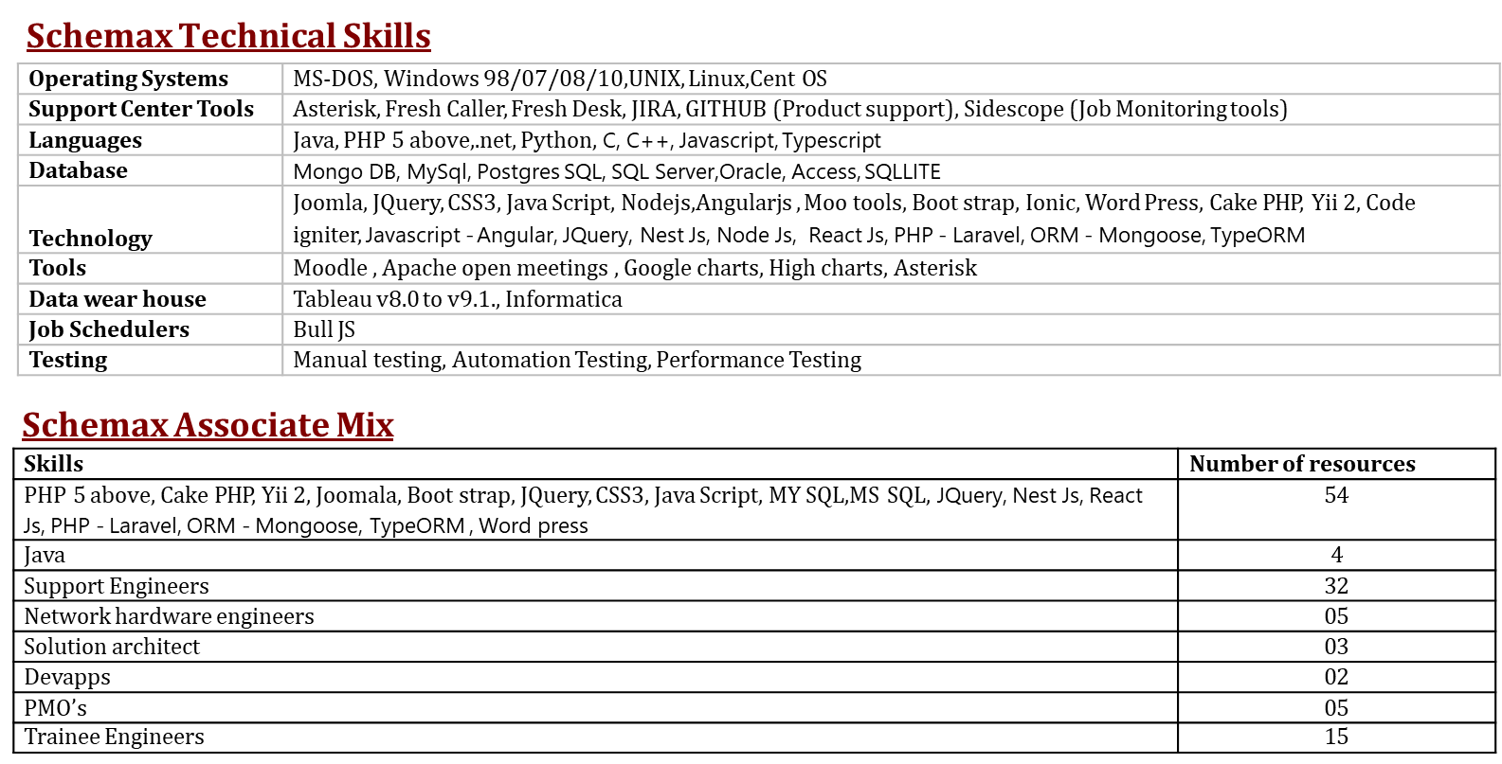
Our Skills

Slide 10



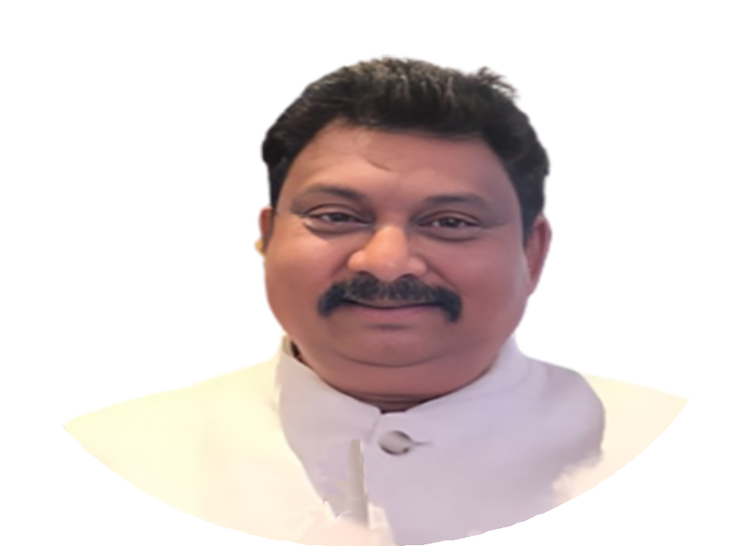
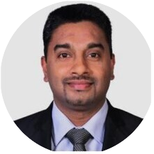
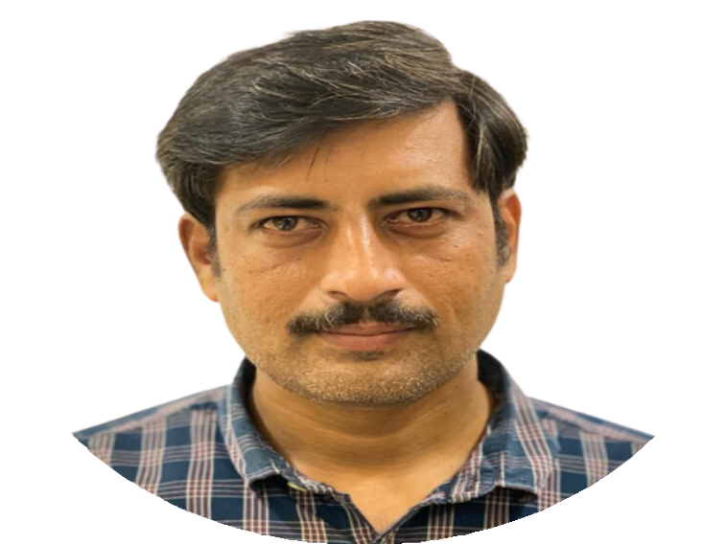

Professional
Leaderboard
Naidu Sunkari
Founder / CEO
Post Graduate in Engineering and over 25 years of global IT experience, ranging from application/system Programmer to project manager, delivery manager, Pre-Sales, Competency Head, Cost center Head, and Location Head, having worked with a diverse range of blue-chip clients such as Nissan (USA), Master Card Inc (USA), ADP (USA), Household INC (owned by HSBC Inc, USA), and General Motors (USA) Deutsche Bank (Singapore), Axa Bank (Beligium) and Pfezier (Japan).
Dinesh Rahubedde
COO
Dinesh Rahubedde is an accomplished professional with a distinguished career spanning over 24 years, showcasing expertise in Finance, Accounting, Banking, IT, Customer Services, Manufacturing, and E-Commerce. Holding esteemed qualifications, including ACMA, CGMA, and CPA, along with a Master of Business Administration (MBA) from the University of London, Dinesh has consistently demonstrated a commitment to excellence and a keen understanding of global business dynamics. He has also successfully completed leadership training at the prestigious Harvard Business School and undergone the LeadershipAt-Peak program at the Center for Creative Leadership in Colorado, USA.
S. RAMAKRISHNA
Director / Architect
Driven by results and motivated to manage budget and build strategic, win-win partnerships and connections with customers, partners, and service providers with overall 11 years of experience.
Adept at forging alliances with organizational leaders to successfully support and align with important business initiatives. excel at attracting and keeping high-performance personnel
through the recruitment, training, and encouragement of competent professionals.

Slide 11
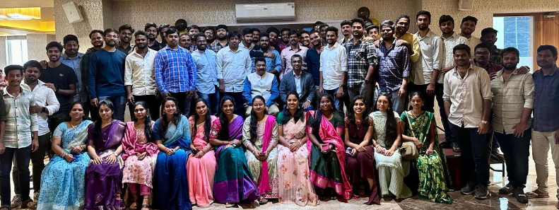
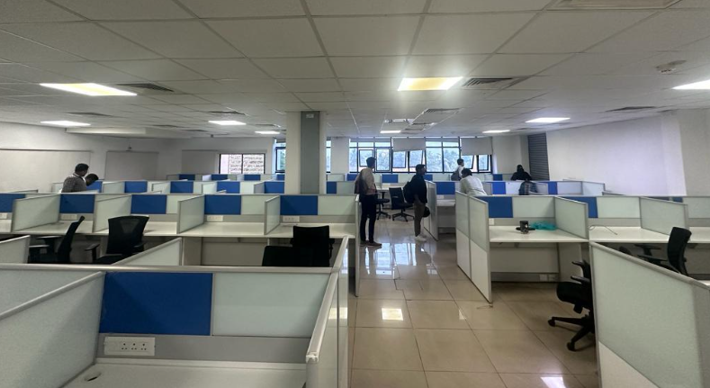
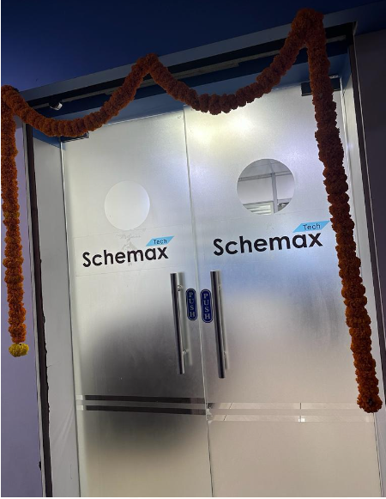
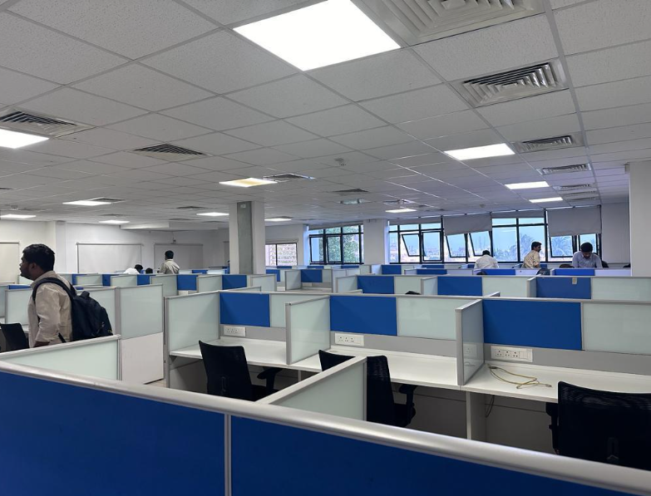
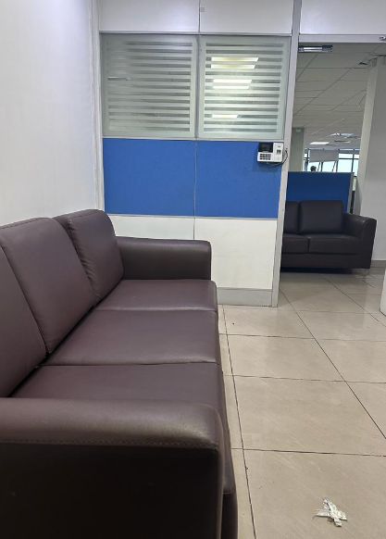
Our Dedicated team

Slide 12

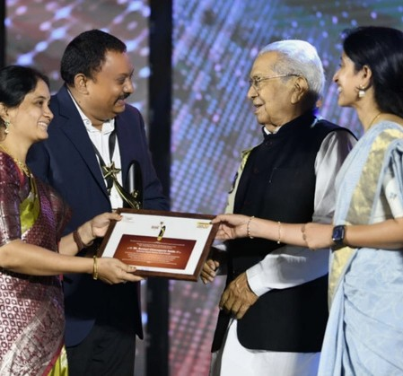
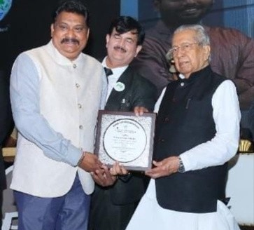

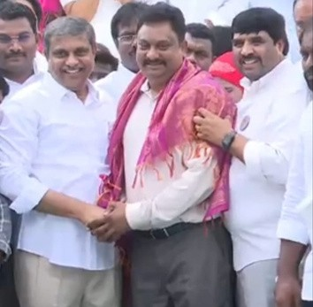
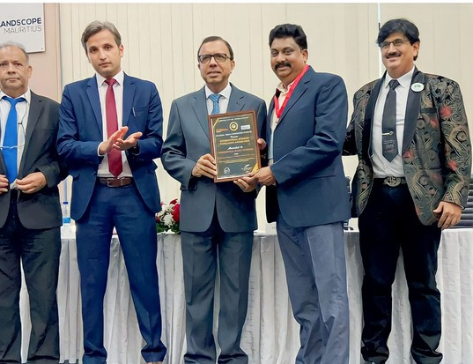

Achievements
and recognitions
2021
Best business person of the year
2021
Award from A.P Governor for creation of poor rural youth job creations
2022
Genius book of records (www.ysrcpblooddonation.com) - Blood donation project 1.5 lacs of blood donation pledged in 24 hours
2022
Best business excellence 2022 Award from A.P Governor for BEST innovative and creative use of technology.
2023
Best business excellence award from Mauritius high commissioner

Slide 13



Contact Information
Phone Number
770-262-1117
Email Address
info@schematech.com
For more information, please get in touch with us.
Website
www.schemaxtech.com

Slide 14




Thank you!
Feel free to approach us if you have any questions.

